Slide 1
Web API Introduction & Practice

Slide 2
Agenda
Basic Http Concept (StatusCode)
ToDoItem Project Requirement
Demo of Console to WebApi
Implement 2 interfaces in Console and WebApi project
Implement All Interface for ToDoItemController
Model Validation
Dependency Injection

Slide 3
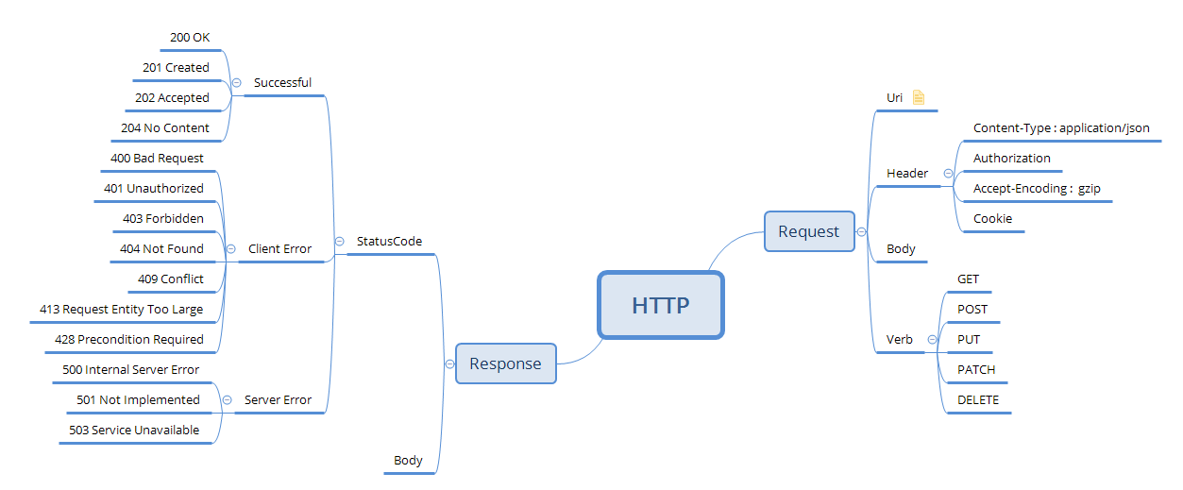
HTTP Basic Concept

Slide 4
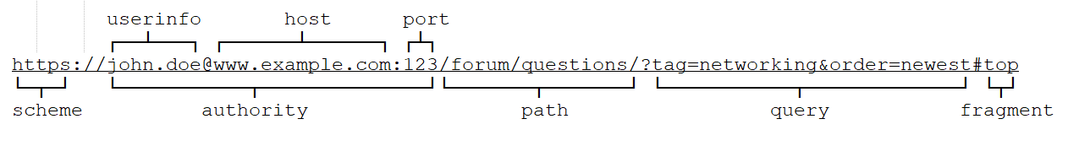
URI
Path: Routing request (api/{noun})
Query: query condition
Port: 5000 for http, 5001 for https

Slide 5
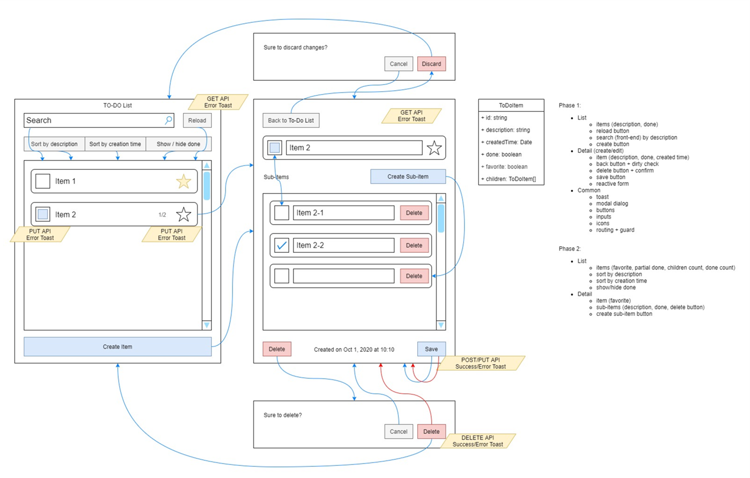
Requirement

Slide 6
WebAPI Interface for ToDoItem
Requirement | Http Method | Path | Request Body | Response Code
Query by Description and Done | GET | api/todoitem?description={keyword}&done=true | none
DELETE by Id | DELETE | api/todoitem/{id} | none
Insert or Update | PUT | api/todoitem | { "Id": "2", "Description": "test item 0", "CreatedTime": "2020-10-09T08:54:06.0272971Z", "Done": false, "Favorite": false, "Children": null }
Partial Update | PATCH | api/todoitem/{id} | { "Description": "Update Description", "Done": true, "Favorite": true, }

Slide 7
Demo Console => WebAPI
Console
WebAPI
Microsoft.NET.Sdk.Web
ConfigureWebHostDefaults
Microsoft.NET.Sdk

Slide 8
SDK
Microsoft.NET.Sdk
Microsoft.NET.Sdk.Web
Microsoft.NET.Sdk.Razor
Microsoft.NET.Sdk.Worker
Microsoft.NET.Sdk.WindowsDesktop
<Project Sdk="Microsoft.NET.Sdk">
<PropertyGroup>
<OutputType>Exe</OutputType>
<TargetFramework>netcoreapp3.1</TargetFramework>
</PropertyGroup>
</Project>

Slide 9
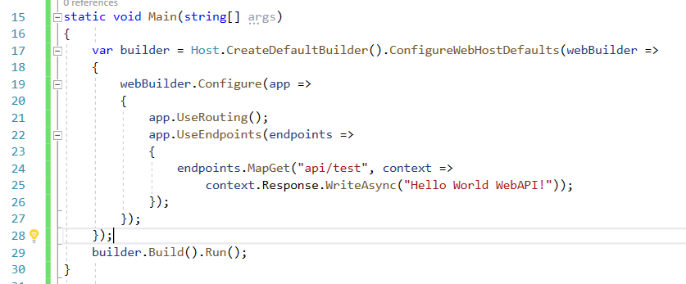
Main()

Slide 10
Demo for Query and Patch in Console App
Requirement | Http Method | Path | Request Body | Response Code
Query by Description and Done | GET | api/todoitem?description={keyword}&done=true | none | 200
Partial Update | PATCH | api/todoitem/{id} | { "Description": "Update Description", "Done": true, "Favorite": true, } | 200, 404
How to Routing
How to get value from Path, QueryString and Body
How to Response

Slide 11
Demo of ToDoItemController
Routing Attribute
Route
HttpGet|HttpPut|HttpPatch
Get Parameter From Path, QueryString and Body
How to Response (OK, NotFound, NoContent)
[Required] attribute

Slide 12
Model for Validation (Attribute)
public class User
{
[Required]
public string Name { get; set; }
//110105198507050042
[RegularExpression(@"\d{18}")]
[JsonProperty("Identity Number")]
public string Id { get; set; }
[EmailAddress]
public string Email { get; set; }
[Url]
public string GitHubUri { get; set; }
[StringLength(256, MinimumLength = 16)]
public string Address { get; set; }
[Range(100, 300)]
public int Hight { get; set; }
[MinLength(1), MaxLength(2)]
public List<string> TelPhone { get; set; }
}

Slide 13
Model for Validation (IValidatableObject)
public class User : IValidatableObject
{
//110105198507050042
[RegularExpression(@"\d{18}")]
[JsonProperty("Identity Number")]
public string Id { get; set; }
[StringLength(256, MinimumLength = 16)]
public string Address { get; set; }
public IEnumerable<ValidationResult> Validate(ValidationContext validationContext)
{
if (Id.StartsWith("110") && !Address.Contains("BeiJing"))
yield return new ValidationResult("Invalid Address");
}
}

Slide 14
Practice
Requirement | Http Method | Path | Request Body | Response Code
DELETE by Id | DELETE | api/todoitem/{id} | none | 204, 404
Insert or Update | PUT | api/todoitem | { "Id": "2", "Description": "test item 0", "CreatedTime": "2020-10-09T08:54:06.0272971Z", "Done": false, "Favorite": false, "Children": null } | 200, 400

Slide 15
Dependency Injection
Dependency Injection (DI) is a design pattern.
It allows the creation of dependent objects outside of a class and provides those objects to a class through different ways.
依赖注入 （DI） 是一种设计模式。
它允许在类之外创建从属对象，并通过不同的方式向类提供这些对象。
Implementing dependency injection provides following advantages:
Reusability of code
Ease of refactoring
Ease of testing

Slide 16
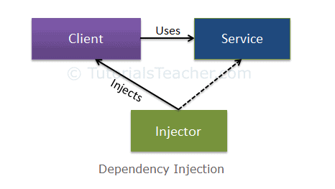
Three Type of Class In Dependency Injection
Client Class: The client class (dependent class) is a class which depends on the service class
Service Class: The service class (dependency) is a class that provides service to the client class.
Injector Class: The injector class injects the service class object into the client class.

Slide 17
Demo of Teacher and Student
Introduce dependency
Introduce dependency Injection
Understand client class, service class and injector

Slide 18
Dependency Injection Time To Live
AddTransient
GetService always return a new created object
AddSingleton
GetService always return one object (Signleton)
AddScoped
GetService always return same object within a request scope, but different across different requests.

Slide 19
Practice DI for MemoryRepository
Add interface for MemoryRepository
Add interface and service map at Startup.ConfigureServices
Which TTL should be use?

Slide 20
Demo of OperationRecord
Understand the AddScoped
Understand [FromService]
var record = new OperationRecord
{
ClientIp = HttpContext.Connection.RemoteIpAddress.ToString(),
UriPath = Request.Path
};

